Slide 1
Project One: Heavy Metal Poisoning and Cardiovascular Disease
aVA Tahmasebi Marie nasara Pietro stolf
Rana Mousavi Ritta Shaheen Robert osei dwomoh
Wayne williams

Slide 2
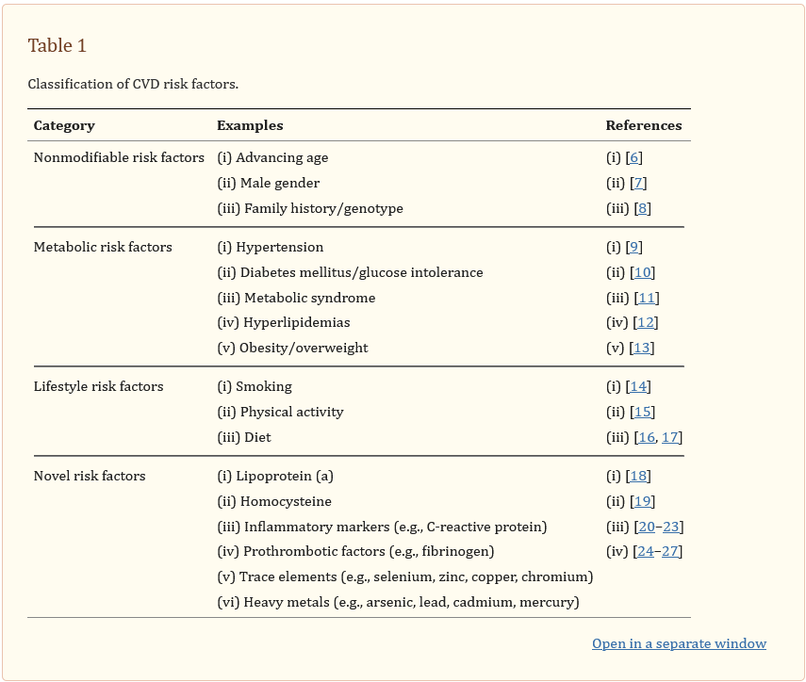
Heavy Metal Poisoning and Cardiovascular Disease (2011)

Slide 3
Dataset - National Health and Nutrition Examination Survey (NHANES) (2013-2014)
The dataset features well-documented heavy metal levels for each participant, specifically: - Lead - Cadmium - Selenium - Manganese - Mercury
The dataset also features lipid levels, specifically: - HDL Cholesterol (good) - LDL Cholesterol (bad) - Triglycerides

Slide 4
Source Material
Heavy Metal Poisoning and Cardiovascular Disease (National Library of Medicine) [Published: September 8, 2011]
https://www.ncbi.nlm.nih.gov/pmc/articles/PMC3168898/
National Health and Nutrition Examination Survey (NHANES Datasets) [Surveyed: 2013-2014]
https://www.kaggle.com/datasets/cdc/national-health-and-nutrition-examination-survey
Environmental Toxic Metal Contaminants and Risk of Cardiovascular Disease [Published: August 29, 2018]
https://www.bmj.com/content/362/bmj.k3310
Metal biomarker mixtures and blood pressure in the United States [Published: February 14, 2021]
https://www.ncbi.nlm.nih.gov/pmc/articles/PMC7883578/
National Library of Medicine (API)
https://www.ncbi.nlm.nih.gov/

Slide 5
Project Premise
The purpose of this project is to investigate whether the presence of heavy metals in the body have a direct contribution to cardiovascular diseases.

Slide 6
Analytical Process
Collect Data
Clean and Preprocess Data
Analyze Data
Interpret Results
Communicate Findings

Slide 7
First Analysis
Clean the data
Create Data Frame
Heat Map

Slide 8
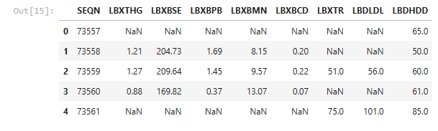

Slide 9
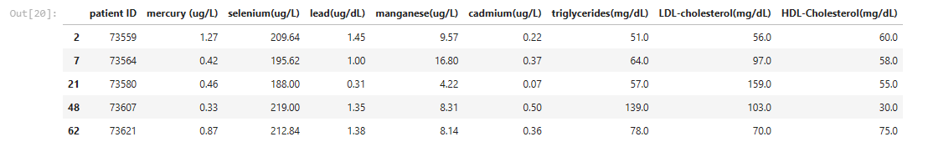

Slide 10
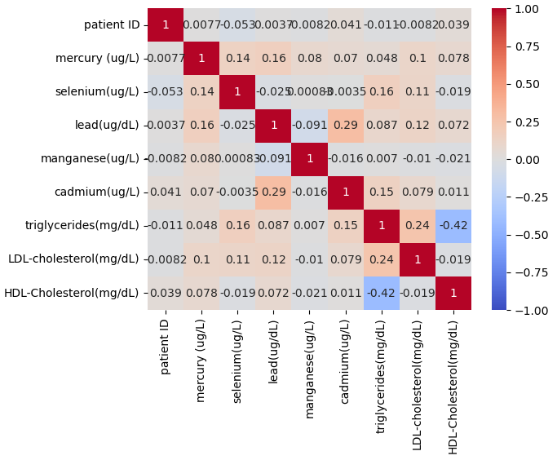
HEATMAP 1

Slide 11
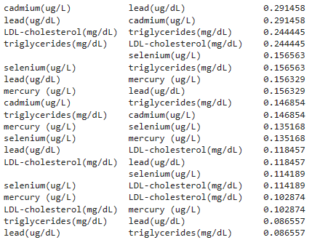

Slide 12
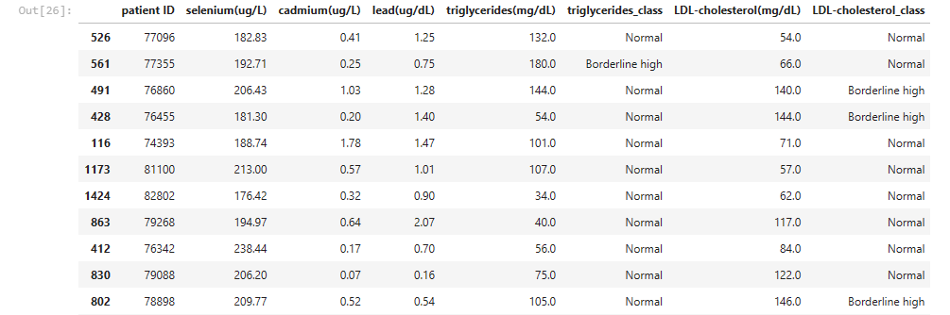
Data Comparison to Medical Norms

Slide 13
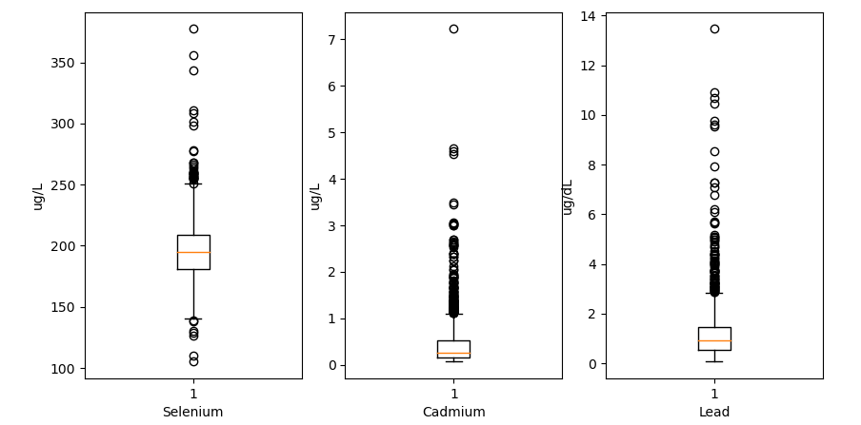
Quartiles of Heavy Metals

Slide 14
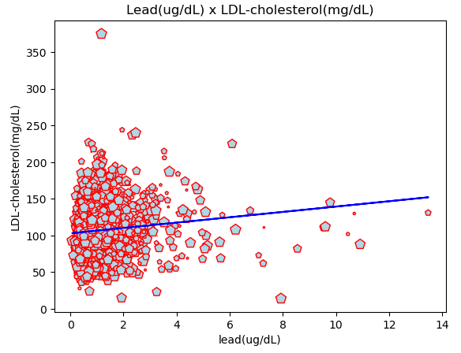
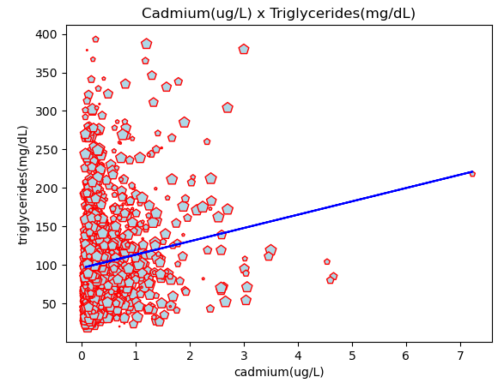
Searching For Correlations

Slide 15
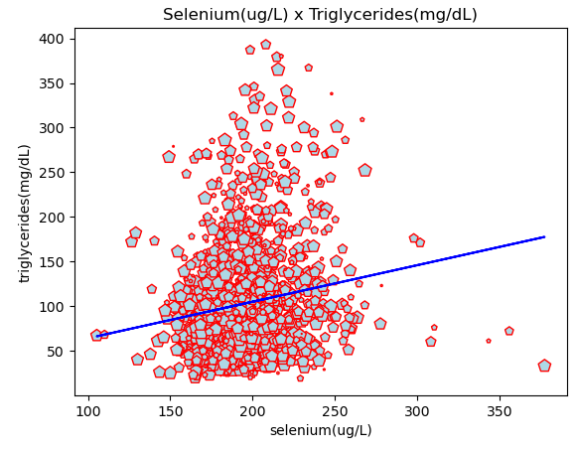
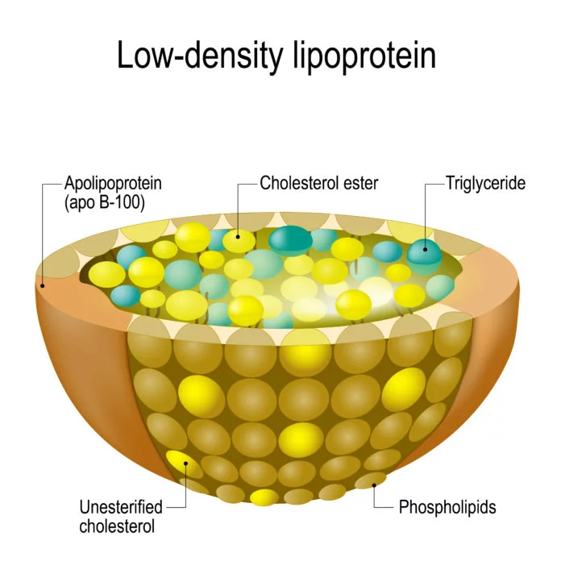
Searching For Correlations

Slide 16
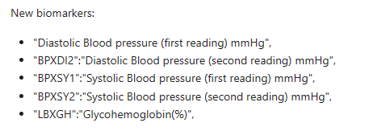
Observations

Slide 17
Adding New Data

Slide 18
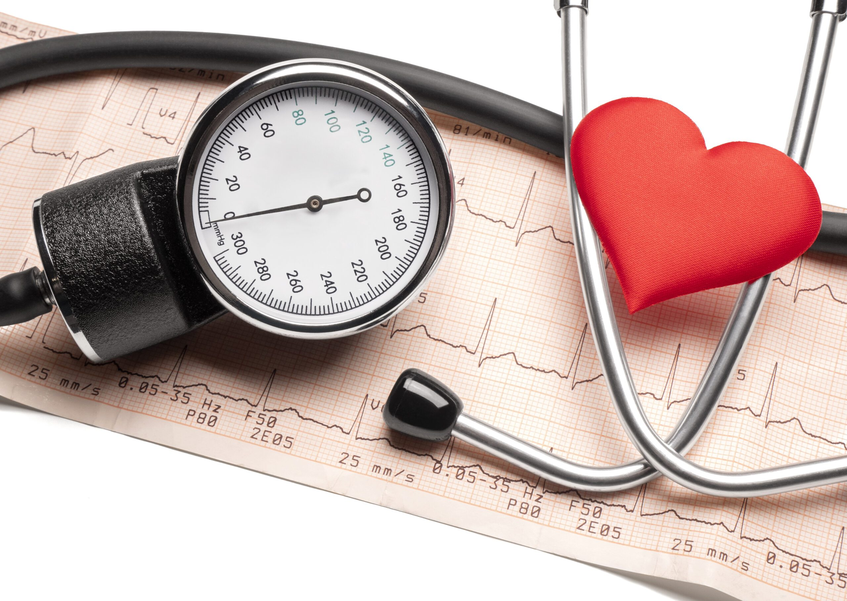
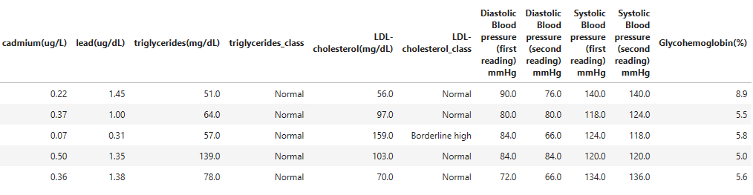

Slide 19
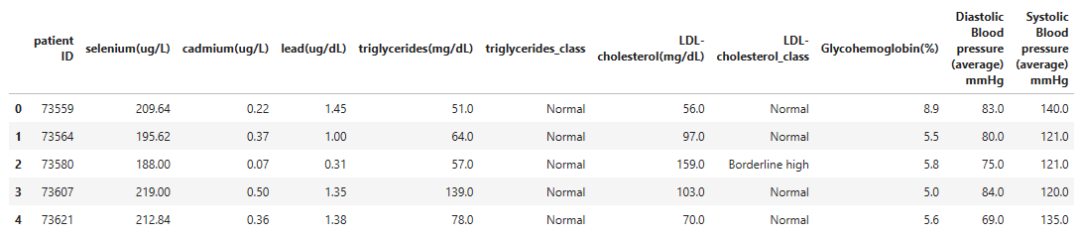

Slide 20
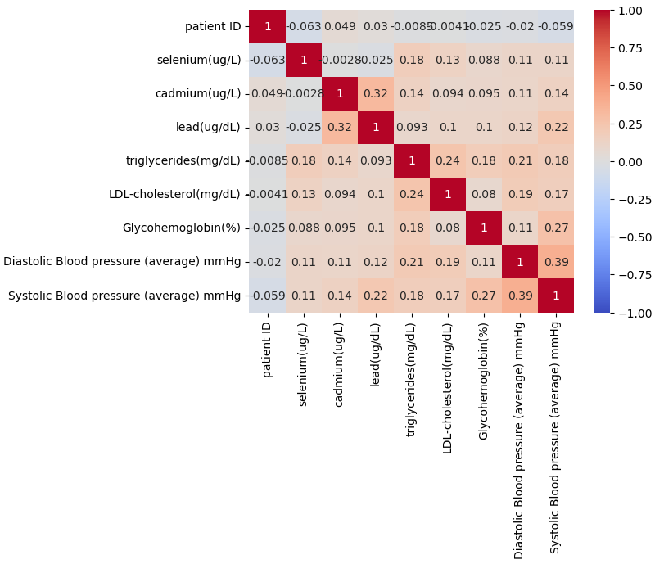
Heat Map 2

Slide 21
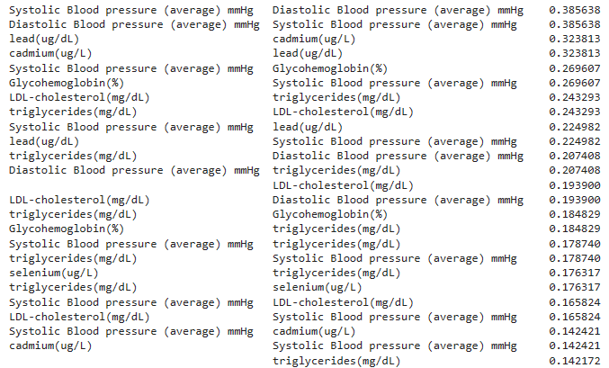

Slide 22
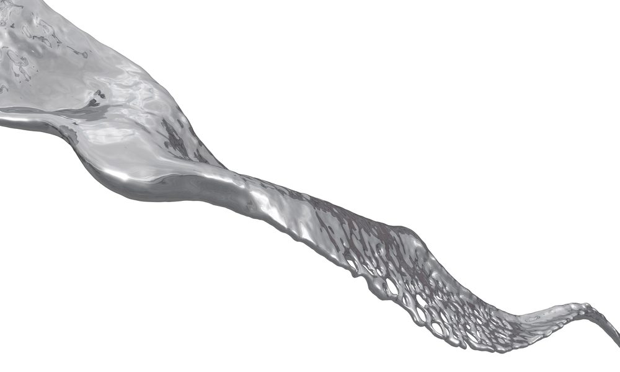
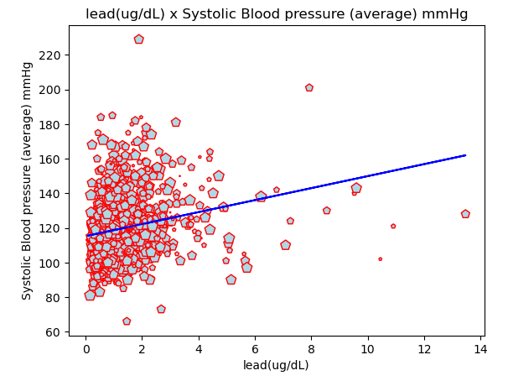

Slide 23
Future API Research

Slide 24
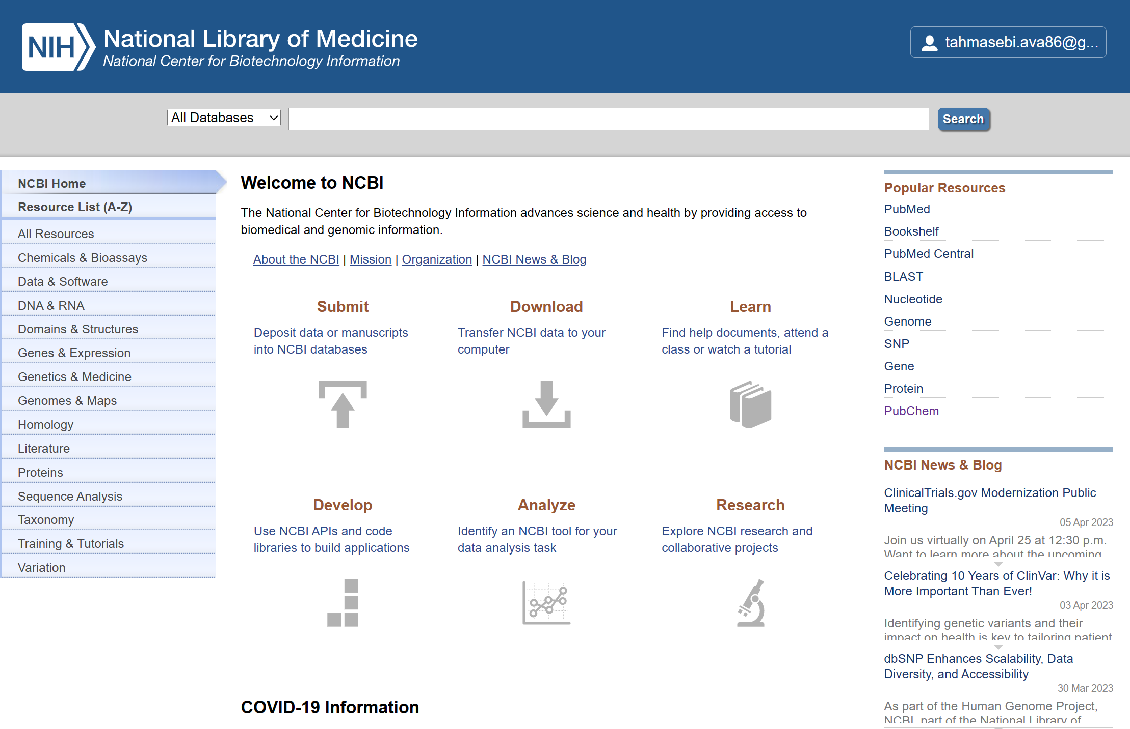

Slide 25
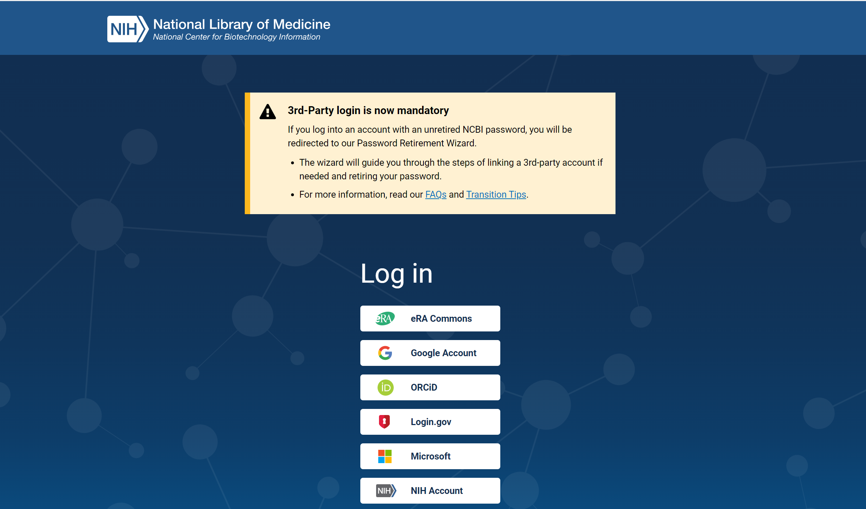

Slide 26
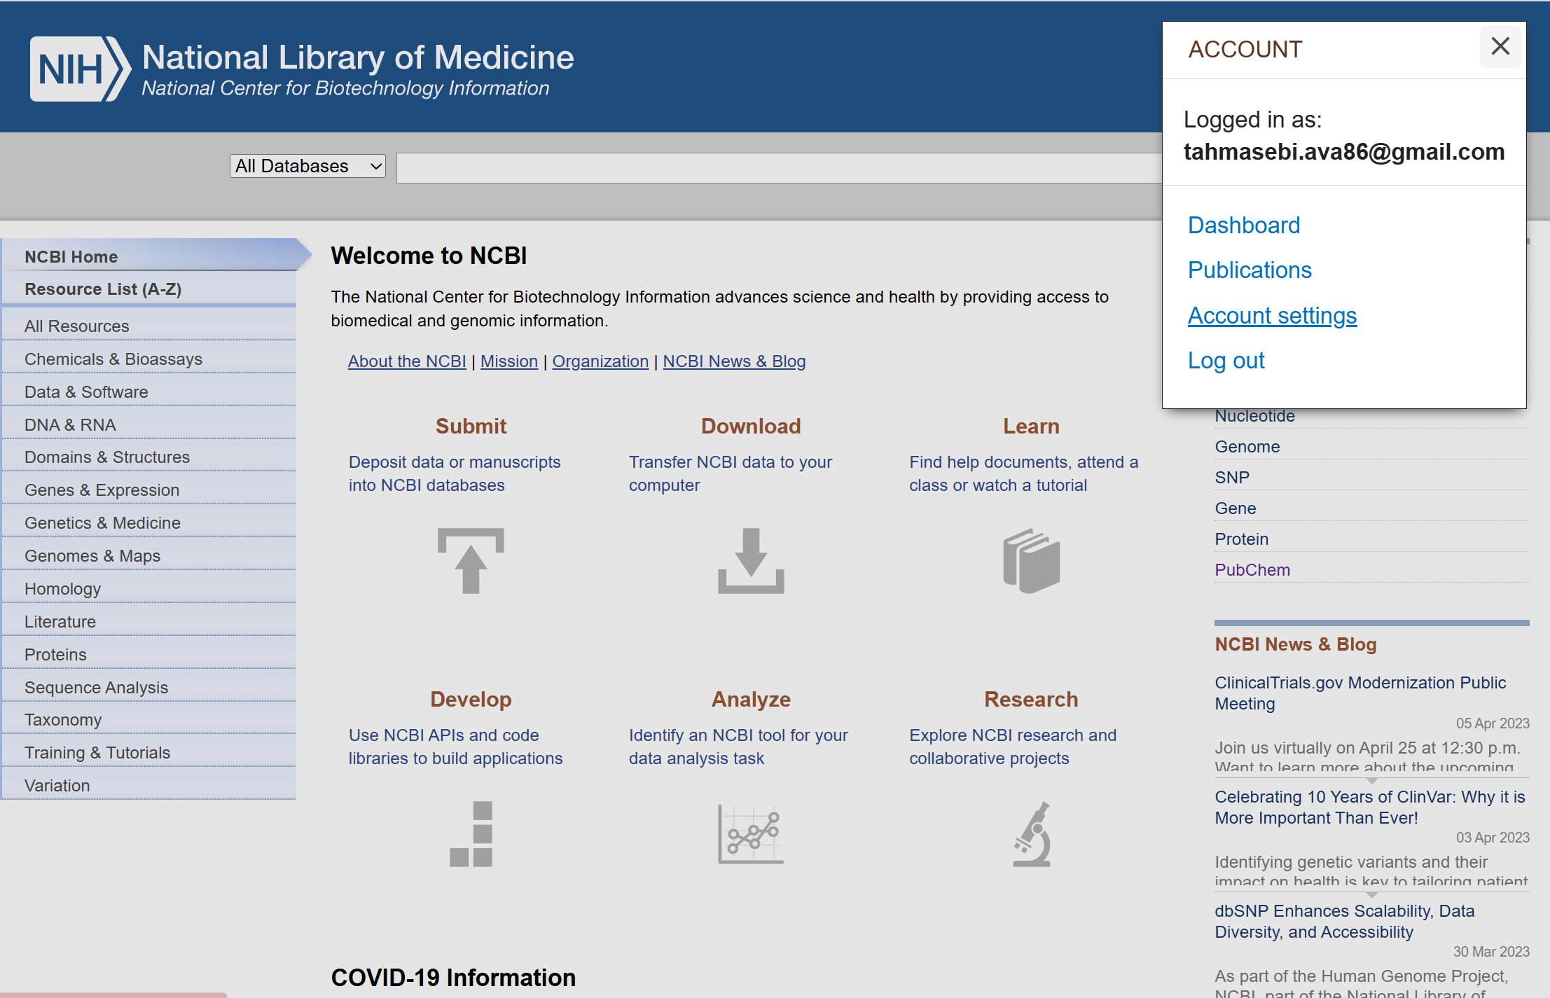

Slide 27
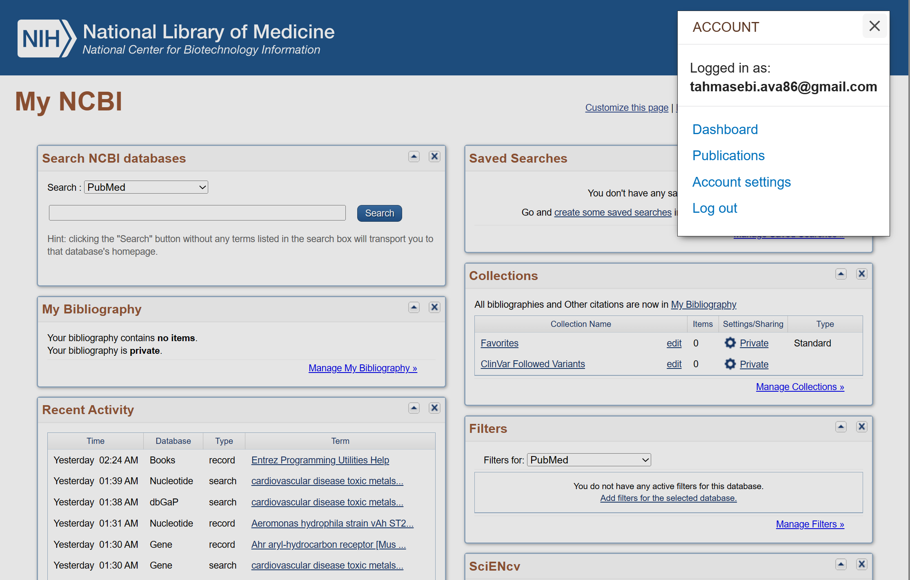

Slide 28
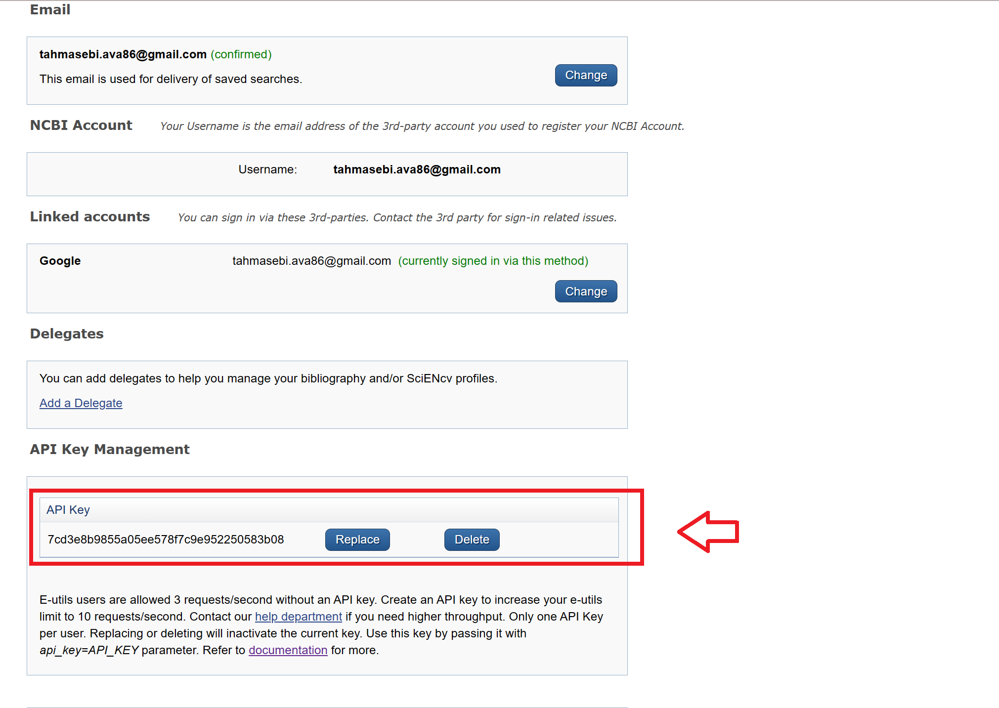

Slide 29
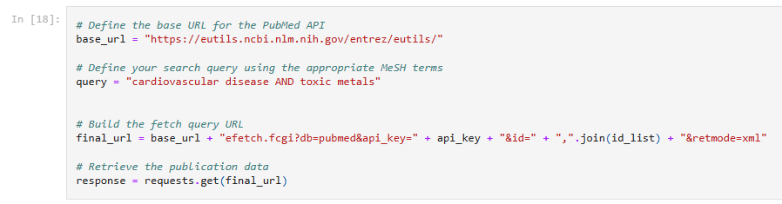


Slide 30
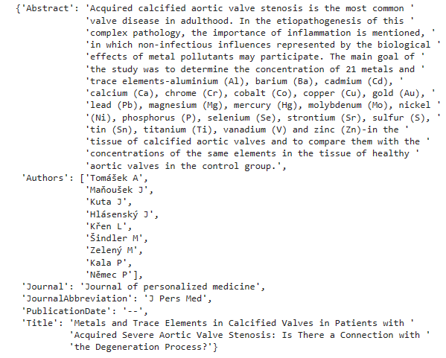

Slide 31
Analysis and Conclusion
In conclusion, toxic heavy metals like mercury, lead, and cadmium are detrimental to our health and increase the risk of heart disease by raising levels of LDL cholesterol. Conversely, essential minerals like selenium and manganese have been shown to be beneficial for heart health by promoting higher levels of HDL cholesterol. Additionally, incorporating predictive variables such as the C-reactive protein (CRP) and urine test samples into our future analysis can provide valuable insights into an individual's risk of developing heart disease by indicating the presence of inflammation. By understanding these factors and incorporating them into our health assessment, we can take proactive steps to minimize our risk of heart disease and lead a healthier life.

